Slide 1
What is a EV Charger??
Used to charge Electric Vehicle
Power from Grid is given to Battery
Electric vehicles (EV) can be charged in a variety of ways, depending on location and requirement.
Specifications and standards for EV chargers, also known as electric vehicle supply equipment (EVSE), vary from one country to another, based on available EV models in the market and the characteristics of the electricity grid.
In India grid is usually AC:Single,three phase
In India: single phase is 230V AC 15 Amp
In India: three phase is 415V AC 125 Amp

Slide 2
EV Charging Methods
Conductive Charging
Inductive Charging
Battery Swapping

Slide 3
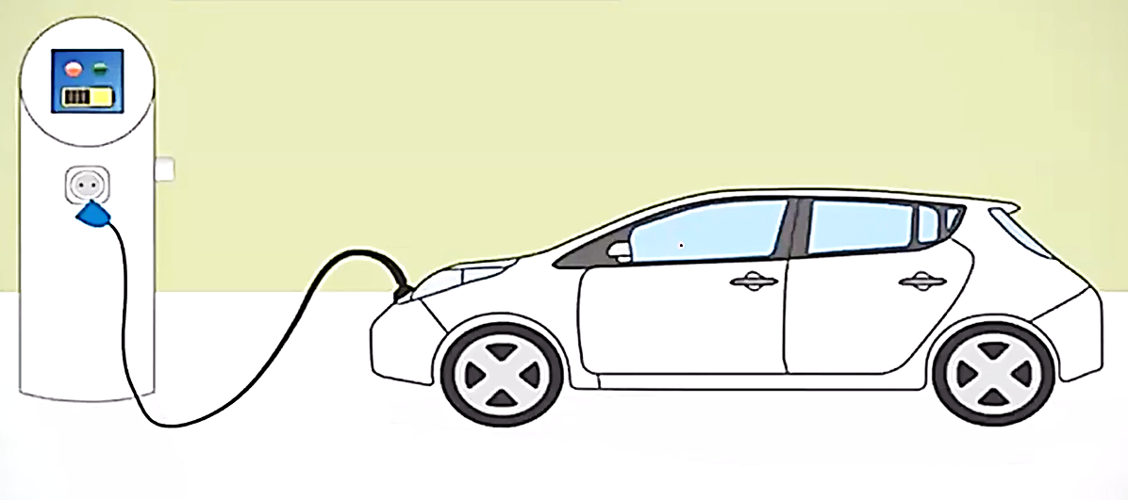
Conductive Charging

Slide 4
Conductive power transfer uses a conductor to connect two electronic devices in order to transfer energy. There are three basic components when it comes to charging an electric vehicle:
The connection defines the performance and the duration of the charging process.
For every type of connection there is a different type of plug.

Slide 5
